Slide 1
User Interface standards
Group 09 UI Team - Mariusz & Taavi

Slide 2
User interface requirements
Use case list
Error conditions

Slide 3
Mock-up*
SceneBuilder / Java 13 / JavaFX 13 / JSON Simple 1.1
*Views are not final and are subject to change

Slide 4
Use case list //TODO – complete that
2.2.1 User can resize window of the app
2.2.2 User can search for words from dictionary
2.2.3 User can scroll list of words to find desired word
2.2.4 User can scroll list of words to find desired word
2.2.5 User can add words to their revision list
2.2.6 User can add new words into the dictionary
2.2.7 User can change the language by which words are sorted
2.2.8 User can remove words from the dictionary
2.2.9 User can edit words from dictionary
2.2.10 User can add/remove words from the revision pool from the Revision List
2.2.11 User can revise words from the word pool
2.2.12 User can use flashcards to revise
2.2.13 User can take tests
2.2.14 User can change settings from revision
2.2.15 User can change the size of the font
2.2.16 User can look at help section

Slide 5
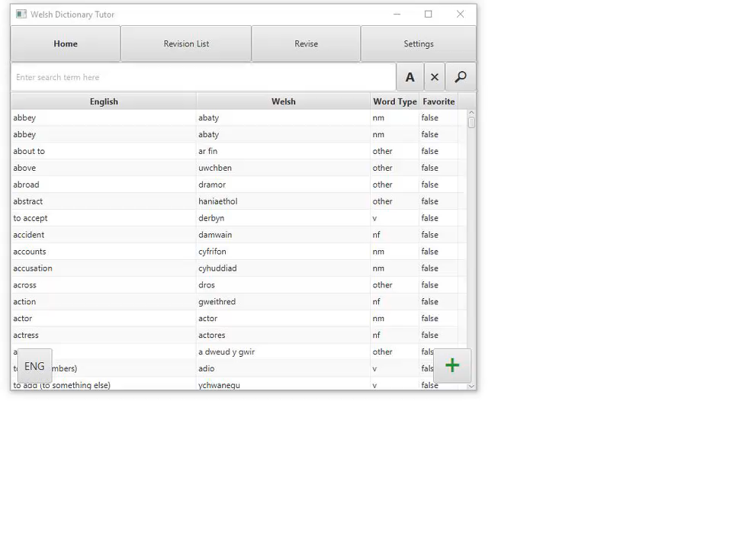
2.2.1 User can resize window of the app
User can resize the window by dragging the corners of the app.

Slide 6
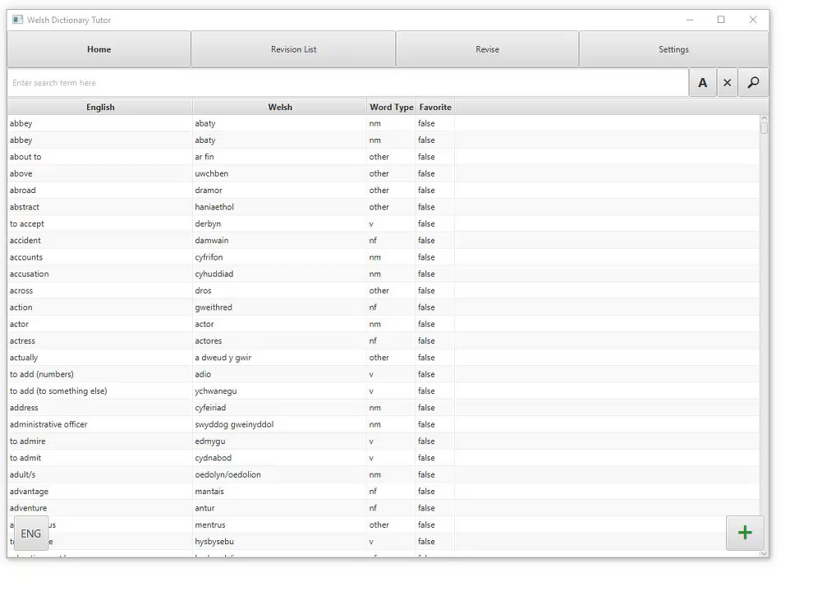
2.2.2 User can search for words from dictionary
User can use the search box to look up words they desire. The user will then see a list of words matching what is currently typed into the search bar, the list is narrowed in real time as the word is being typed.

Slide 7
2.2.3 User can search for words starting with a specific letter
When the user wishes to narrow down the list to words that start with a specific letter, they can use the button labelled “A”. When pressed, a menu composed of the current active language’s alphabet is opened. Each letter is a separate button and clicking on one closes the window, filling out the search bar with that letter.

Slide 8
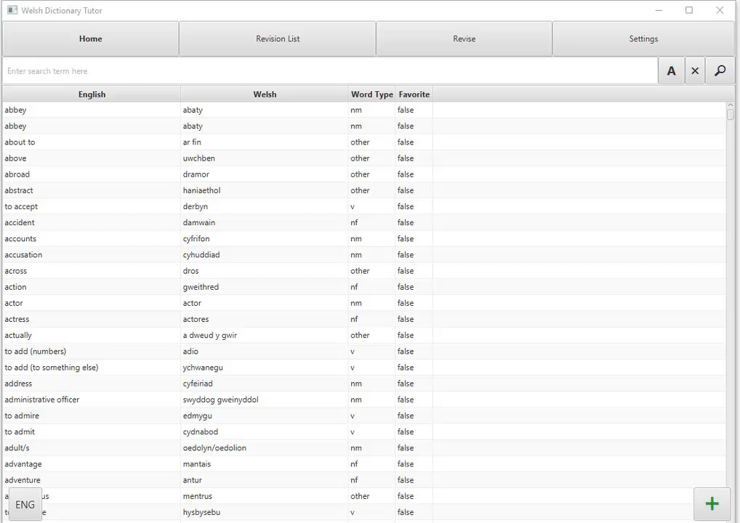
2.2.4 User can scroll list of words to find desired word
User can scroll the list by dragging the scroll pane located on the right side of the window. The scroll can be dragged either up or down. Furthermore, the user can choose to scroll with his mouse or touchpad.

Slide 9
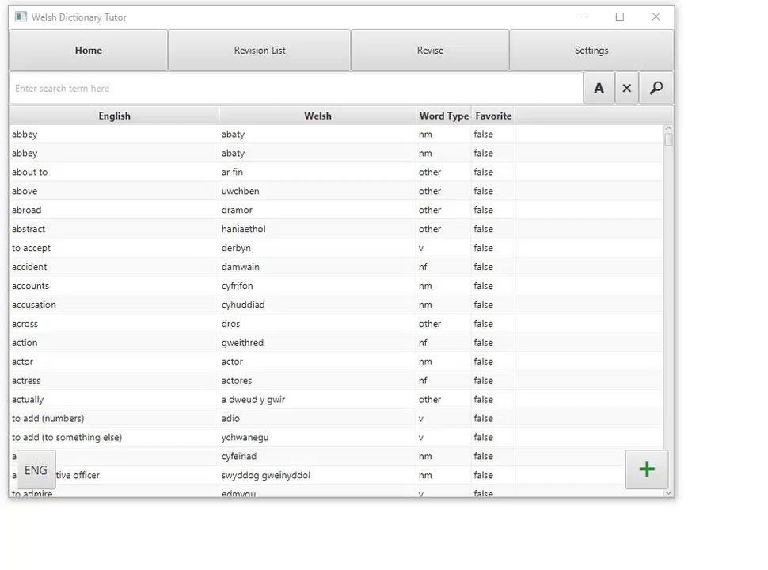
2.2.5 User can add words to their revision list
The user can add a word to their revision list by double clicking on the desired word in the dictionary list. The word will be marked as favourite – true.

Slide 10
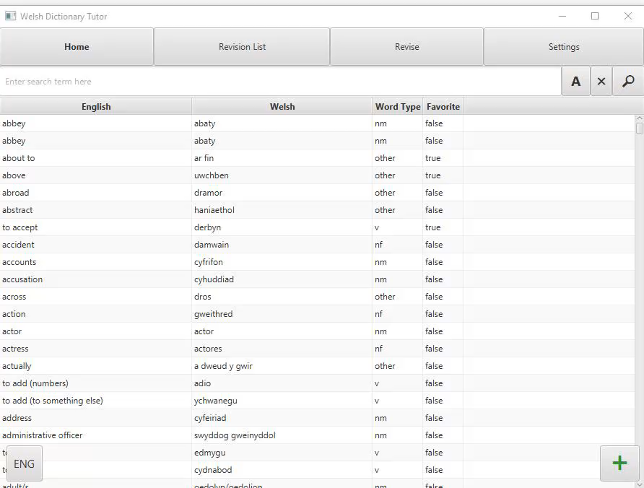
2.2.6 User can add new words into the dictionary
The user can press the floating green plus button located on the bottom right corner of the window. A dialog box is opened in the middle of the screen after the user clicks the button. The dialog box consists of the English and Welsh definition boxes and a drop-down menu to select the word type. There is a “Add new word” button that is inactive on opening. Once the user has filled in all the boxes, the button “Add new word” changes colour and becomes active. Once the “Add new word” is clicked, the word is added to the dictionary and the dialog box closed.

Slide 11
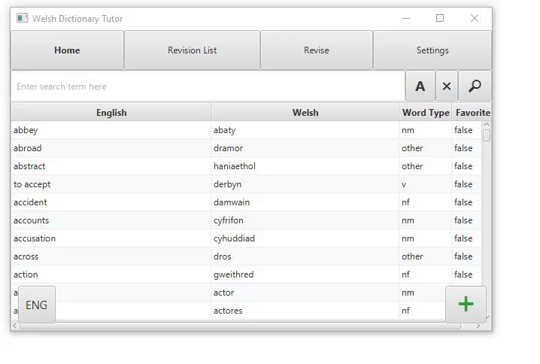
2.2.7 User can change language by which words are sorted
The user can click on the button located on the bottom left corner of the screen. The button depicts the current language, abbreviated to “ENG” or “CY” for English and Welsh appropriately. When clicked the language in which the words are sorted is changed and the button takes on the appropriate label. Afterwards, the table is sorted alphabetically by the current language. The sorting carries over to the narrowing list in Use Case 2.2.2.

Slide 12
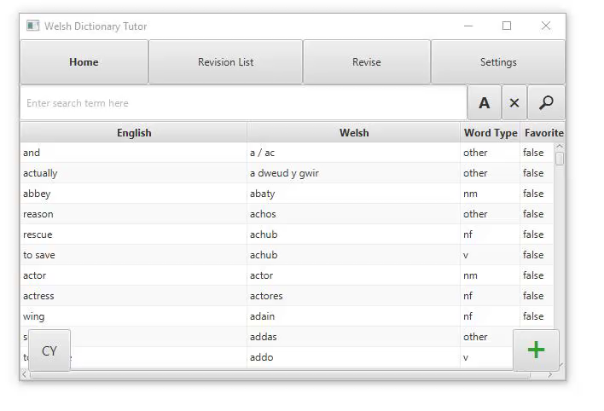
2.2.8 User can remove words from dictionary
The user can remove words from dictionary by right clicking the word, a drop-down menu is then displayed giving the options “DELETE” and “EDIT”. When “DELETE” is chosen, the word will be removed from the dictionary.

Slide 13
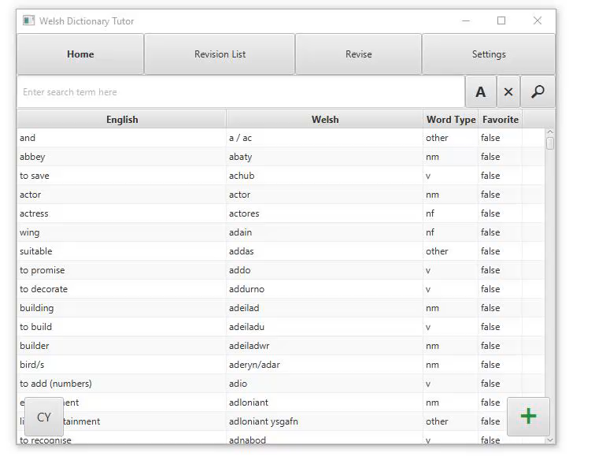
2.2.9 User can edit words from dictionary
The user can edit words from the dictionary by right clicking the word. When right clicked a drop-down box is the displayed giving the options “DELETE” and “EDIT”. When edit is selected a dialog window is shown, this contains two textboxes, one drop-down menu and a confirmation button. Here the user can edit the English definition, Welsh definition and the type of the word. Once they click the "Revise word” button, the dialog box is closed.

Slide 14
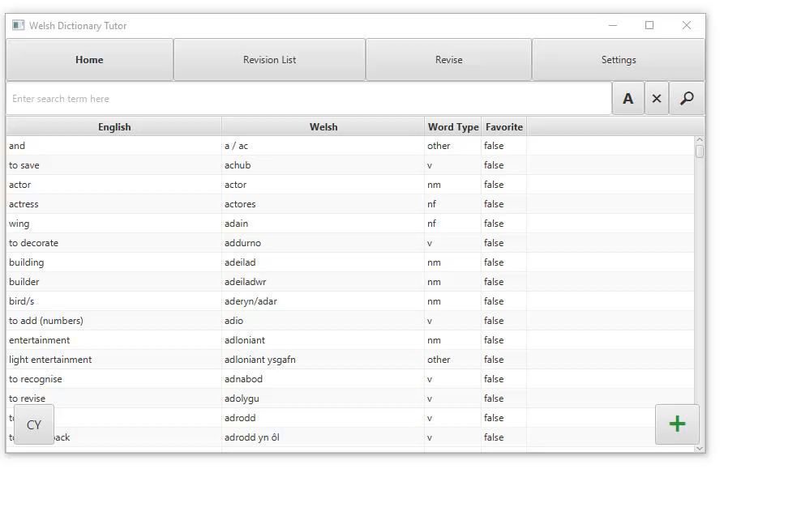
2.2.10 User can add/remove words from the revision pool from the Revision list
The user can add words to the revision list by double clicking the word in the dictionary list. Once clicked, the word is added to the Revision List. The user can remove the word from the Revision list by double clicking on the word in either the Revision list or the home screen. Once removed, the word will disappear from the list.

Slide 15
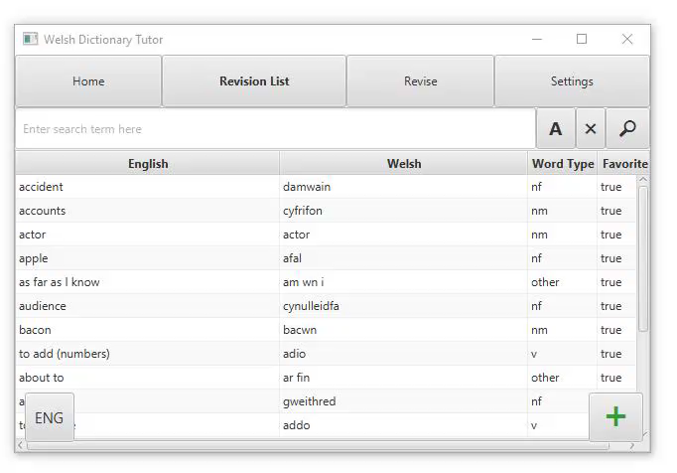
2.2.11 User can revise words from the word pool
When the user wants to revise the words from the revision list they click on the button along the top of the screen labelled “REVISE”. This shows them a new page containing two buttons, “FLASH CARDS” and “QUIZ”. From here they can choose two ways to revise, these two options are described in use cases 2.2.12 and 2.2.13.

Slide 16
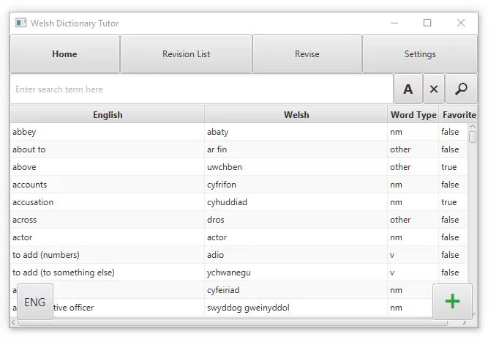
2.2.12 User can use flashcards to revise
Once the user chooses the “Revise” menu and clicks on the “Flashcard” option, they’ll be presented with a flashcard (only if they have at least one word added to the revision list). They can flip the flashcard to see the definition in the other language by clicking the Flip button. The user can click the “NEXT” button when they want to see a new word.

Slide 17
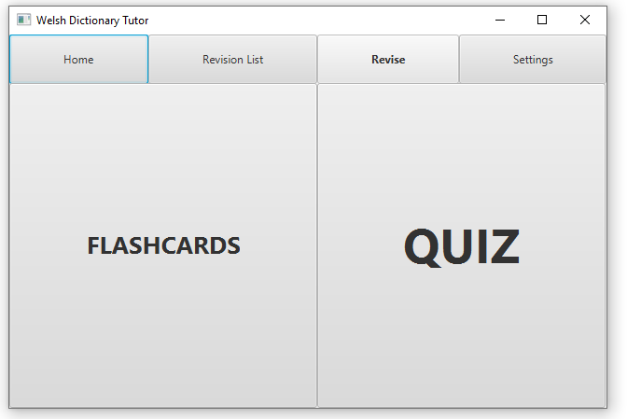
2.2.13 User can take tests
Once the user chooses the “Revise” menu and clicks on the “Quiz” option, they’ll be presented with a quiz of various tests, with the amount dependant on the setting they have chosen in the “Settings” menu. They’ll be presented one of three tests at a time.
There is a running indicator in the form of a progress bar to show how many of the questions the user has answered correctly. There is also a numeric indicator for how many questions have been answered out of the total number of questions.

Slide 18
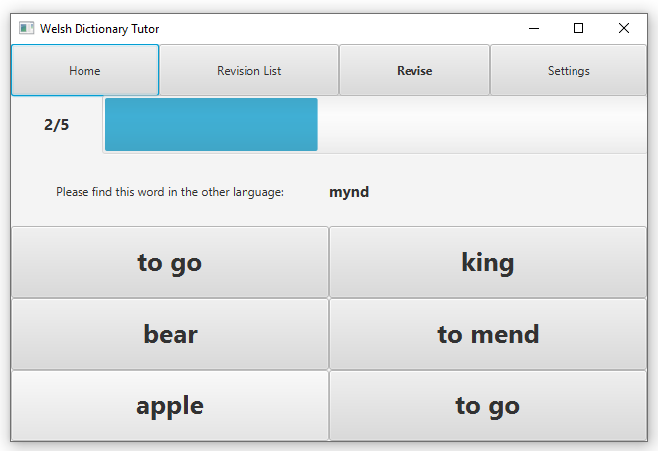
2.2.13 User can take tests
A)Find the definition – The user will be presented a word in a language (dependant on the language setting in the “Settings”) and they’ll be shown 6 random words from the dictionary in the other language. They must choose the correct matching definition.

Slide 19
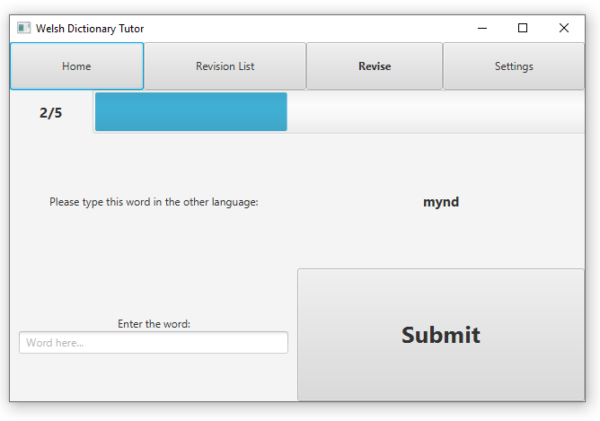
2.2.13 User can take tests
B)Input box – The user will be presented a word in a language (dependant on the language setting in the “Settings”) and they’ll have an input box. They must write the correct definition in the input box.

Slide 20
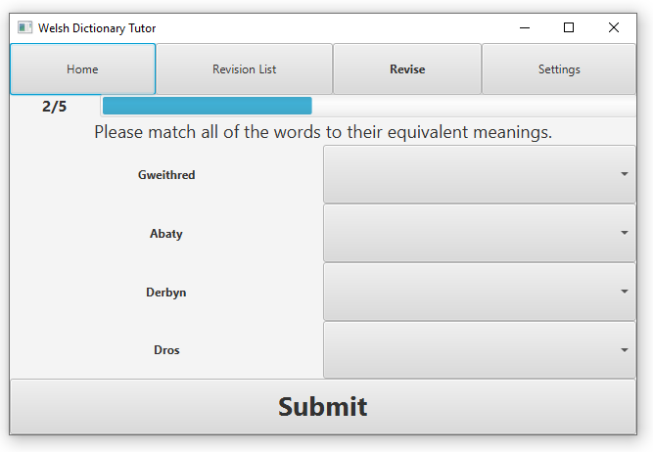
2.2.13 User can take tests
C)Matching – The user will be presented 4 words in a language (dependent on the language setting in the “Settings”) and they’ll be shown 4 drop-down menus with the matching definitions to the word. They must match up each word to its correct definition in the other language.

Slide 21
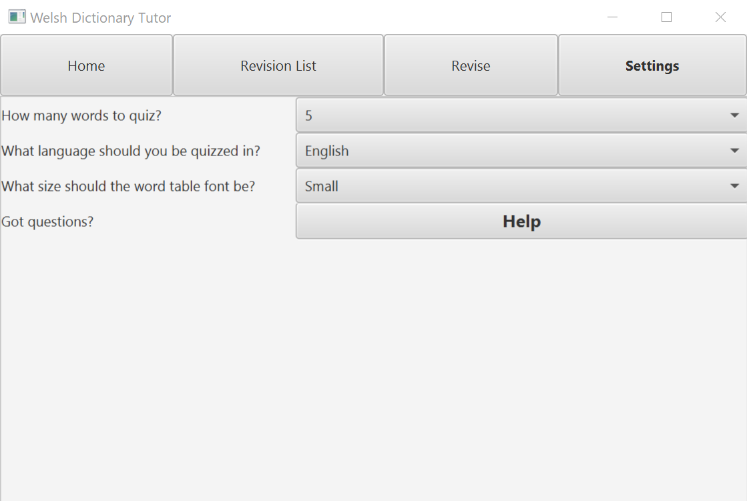
2.2.14 User can change settings for revision
User can click on the button “Settings” on the main menu bar at the top of the screen. On the settings page the user can change
How many tests are used in a single quiz (5 or more in increments of 5 up to a maximum of 30)
What language should be used for the tests and flashcards (English, Welsh or both)
Click on the Help button for a help screen

Slide 22
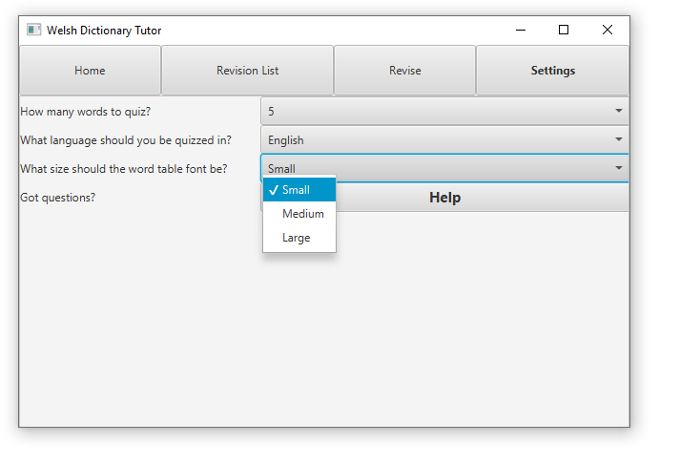
2.2.15 User can change the size of the font
Welsh Vocabulary Tutor is accessibility friendly. User can change the size of the font presented in the application. Once they click the “Settings” button located in the navigation menu, they can choose from one of three options available
Small – 12 pixels
Medium – 18 pixels
Large – 28 pixels
After choosing those options, the user will see the change of font size in Main and Revision List section.

Slide 23
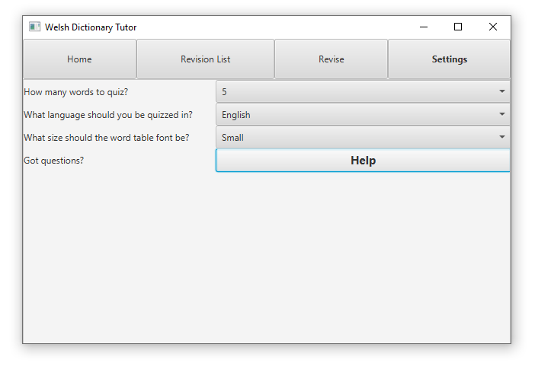
2.2.16 User can get help from Help section
User can find all the instructions how to use the app by clicking on Settings and clicking on “HELP” button. From there the dialog box opens with all the information how to use the application

Slide 24
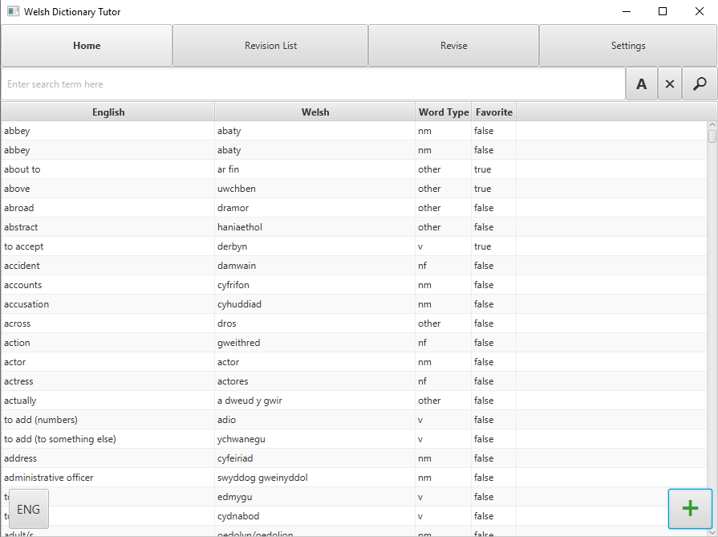
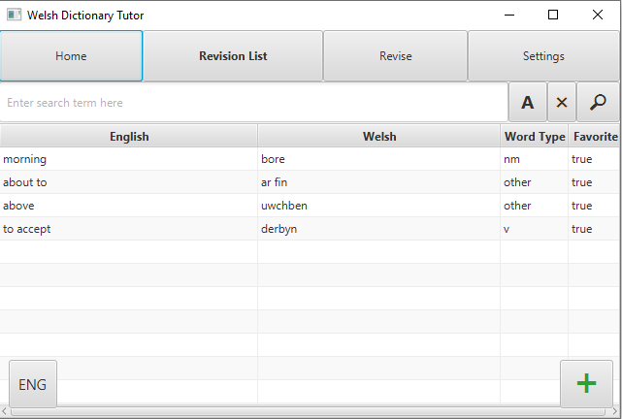
Mock up views pt.1

Slide 25
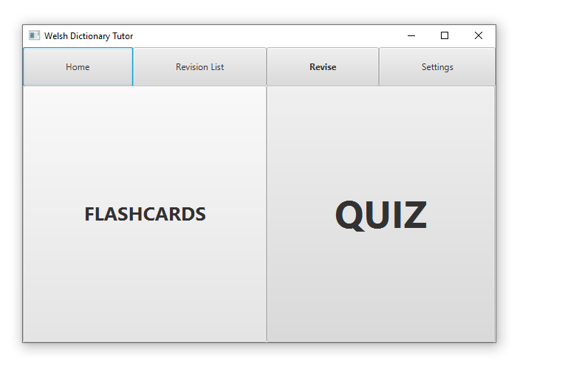
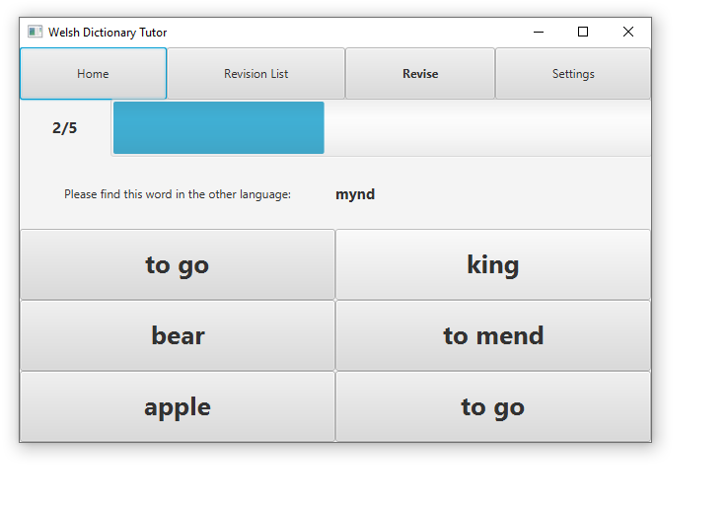
Mock up views – pt 2

Slide 26

Error conditions
Empty box - user doesn't input the word when he is supposed to
User chooses to open Revise section where there are no words added to revision list

